Slide 1
Digital Signal Processing(BEC-42)
Unit-1
Lecture-2
Presented By:
Dr. Satish Chandra

Slide 2
What is a System?
Systems process input signals to produce output signals.
Examples:
A circuit involving a capacitor can be viewed as a system that transforms the source voltage (signal) to the voltage (signal) across the capacitor
A CD player takes the signal on the CD and transforms it into a signal sent to the loud speaker
A communication system is generally composed of three sub- systems, the transmitter, the channel and the receiver. The channel typically attenuates and adds noise to the transmitted signal which must be processed by the receiver

Slide 3
How is a System Represented?
A system takes a signal as an input and transforms it into another signal
Input signal
x(t)
System
Output signal y(t)
In a very broad sense, a system can be represented as the ratio of the output signal over the input signal
That way, when we “multiply” the system by the input signal, we get the output signal
This concept will be firmed up in the coming weeks

Slide 4
Types of Systems
Causal & Non-causal
Linear & Non Linear
Time Variant &Time-invariant
Stable & Unstable
Static & Dynamic
Invertible

Slide 5
Causal Systems
Causal system : A system is said to be causal if the present value of the output signal depends only on the present and/or past values of the input signal.
Example: y[n]=x[n]+1/2x[n-1]

Slide 6
Non-causal Systems
Non-causal system : A system is said to be anticausal if the present value of the output signal depends only on the future values of the input signal.
Example: y[n]=x[n+1]+1/2x[n-1]

Slide 7
Linear & Non Linear Systems
A system is said to be linear if it satisfies the principle of superposition
For checking the linearity of the given system, firstly we check the response due to linear combination of inputs
Then we combine the two outputs linearly in the same manner as the inputs are combined and again total response is checked
If response in step 2 and 3 are the same,the system is linear othewise it is non linear.

Slide 8
Time Invariant and Time Variant Systems
A system is said to be time invariant if a time delay or time advance of the input signal leads to a identical time shift in the output signal.
y_{i} (t) = H{x(t − t₀ )}
= H{S^{t 0}{x(t)}} = HS^{t 0}{x(t)}
y (t) = S^{t 0}{y(t)}
0
= S^{t 0}{H{x(t)}} = S^{t 0} H{x(t)}

Slide 9
Linear Time-Invariant Systems
Special importance for their mathematical tractability
Most signal processing applications involve LTI systems
LTI system can be completely characterized by their impulse response
y [n ] =T {x [n ]} =T ⎧
∞
x [k ]δ [n − k ]⎫ Linearity
⎨ ∑
⎬
⎩k =−∞ ⎭
∞ ∞
∑ x [k ]T {δ [n − k ]} = ∑ x [k ]h_{k} [n ]Time − Inv
k =−∞ k =−∞
∑ x [k ] h [n − k ] = x [k ]∗ h [k ]
k =−∞
∞

Slide 10
Stable & Unstable Systems
A system is said to be bounded-input bounded-output stable (BIBO stable) iff every bounded input results in a bounded output.
i.e.
∀t | x(t) |≤ M_{x} < ∞ → ∀t | y(t) |≤ M_{y} < ∞

Slide 11
Stable & Unstable Systems
Example: The system represented by
y(t) = A x(t) is unstable ; A˃1
Reason: let us assume x(t) = u(t), then at every instant u(t) will keep on multiplying with A and hence it will not be bonded.

Slide 12
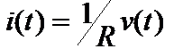
Static Systems
A static system is memoryless system
It has no storage devices
its output signal depends on present values of the input signal
For example

Slide 13
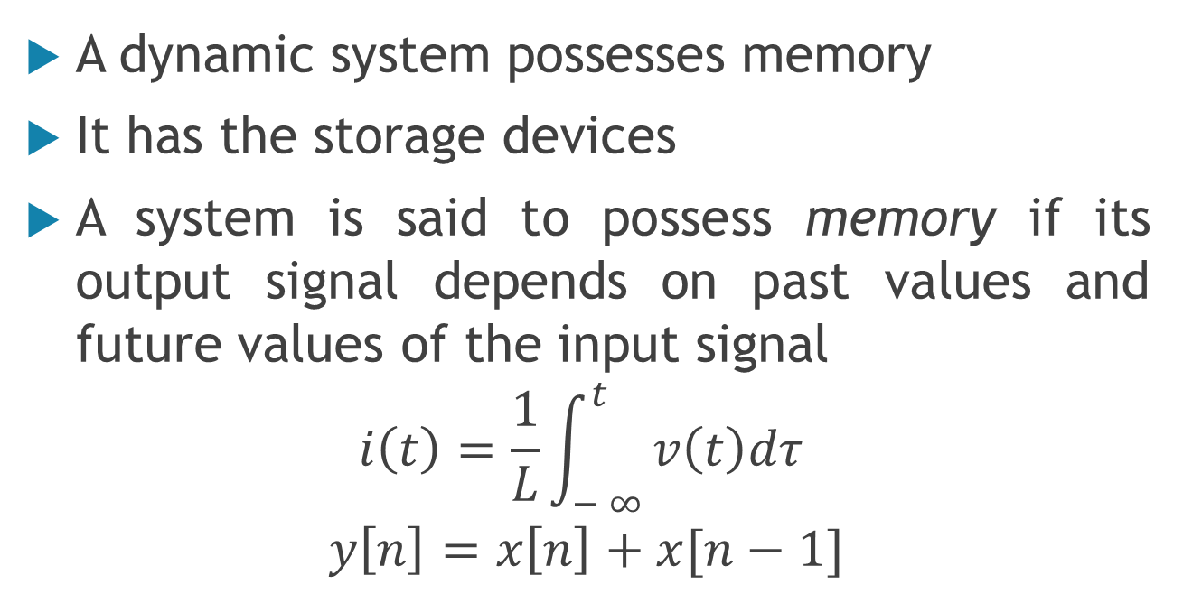
Dynamic Systems
A dynamic system possesses memory
It has the storage devices
A system is said to possess memory if its output signal depends on past values and future values of the input signal
$$i\left(t\right)=\frac{1}{L}\int_{− ∞ }^{t}{v\left(t\right)dτ }$$
$$y\left[n\right]=x\left[n\right]+x[n−1]$$

Slide 14
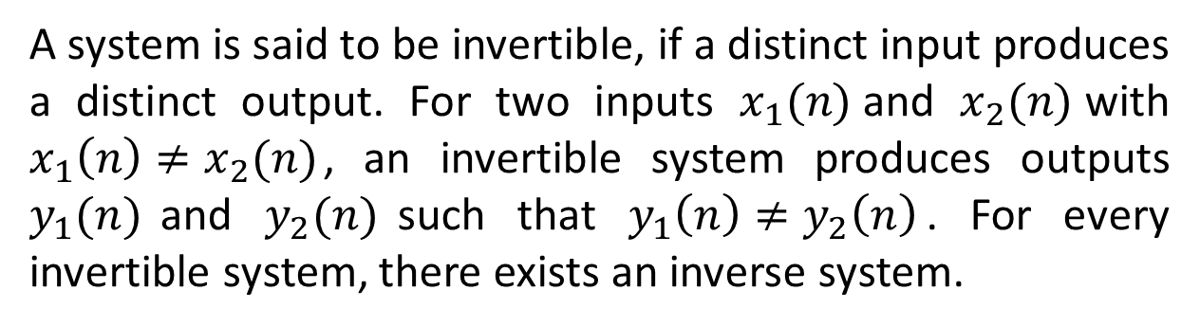
Invertible Systems
A system is said to be invertible, if a distinct input produces a distinct output. For two inputs $x_{1}(n)$and $x_{2}(n)$with $x_{1}\left(n\right)≠x_{2}(n)$, an invertible system produces outputs $y_{1}(n)$and $y_{2}(n)$such that $y_{1}\left(n\right)≠y_{2}\left(n\right)$. For every invertible system, there exists an inverse system.

Slide 15
Memoryless System
A system is memoryless if the output y[n] at every value of n depends only on the input x[n] at the same value of n
Example :
y[n] = (x[n])²
Square
y[n] = sign{x[n]}
Sign
counter example: Ideal Delay System
y[n] = x[n − n_{o}]

Slide 16
Discrete-Time Systems
Discrete-Time Sequence is a mathematical operation that maps a
given input sequence x[n] into an output sequence y[n]
T{.}
y[n] = T{x[n]}
x[n]
y[n]
Example Discrete-Time Systems
Moving (Running) Average
y[n] = x[n] + x[n − 1] + x[n − 2] + x[n − 3]
Maximum
y[n] = max {x[n], x[n − 1], x[n − 2]}
Ideal Delay System
y[n] = x[n − n_{o}]

Slide 17
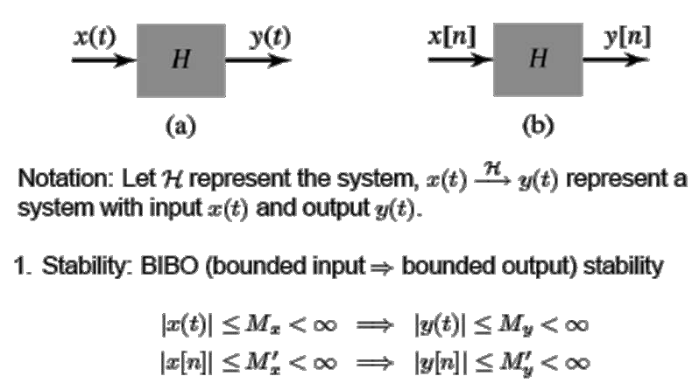
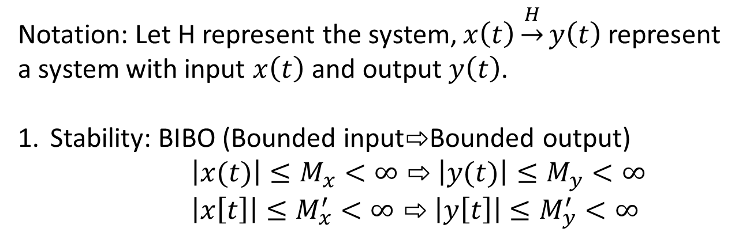
System Properties
Notation: Let H represent the system, $x\left(t\right)\underset{→}{H}y\left(t\right)$ represent a system with input $x\left(t\right)$ and output $y\left(t\right)$.
Stability: BIBO (Bounded input$⇨$Bounded output)
$\left|x(t)\right|≤M_{x}<∞⇨$ $\left|y(t)\right|≤M_{y}<∞$
$\left|x\left[t\right]\right|≤M_{x}^{′}<∞⇨$ $\left|y\left[t\right]\right|≤M_{y}^{′}<∞$

Slide 18
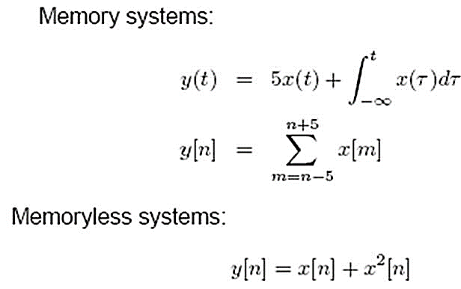
2.Memory /Memoryless:
Memory system: present future/past input.
output value depend on
Memoryless system: present output value depend only on present input.
Example:

Slide 19
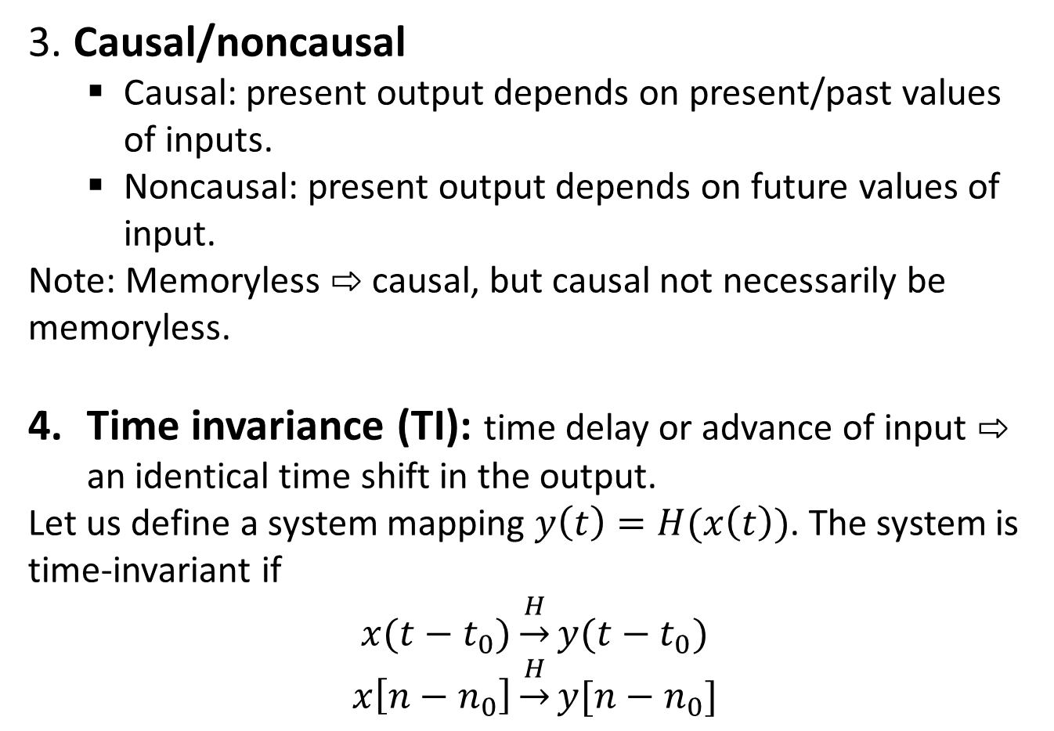
3. Causal/noncausal
Causal: present output depends on present/past values of inputs.
Noncausal: present output depends on future values of input.
Note: Memoryless $⇨$ causal, but causal not necessarily be memoryless.
Time invariance (TI): time delay or advance of input $⇨$ an identical time shift in the output.
Let us define a system mapping $y\left(t\right)=H(x\left(t\right))$. The system is time-invariant if
$$x(t−t_{0})\underset{→}{H}y(t−t_{0})$$
$$x\left[n−n_{0}\right]\underset{→}{H}y[n−n_{0}]$$

Slide 20
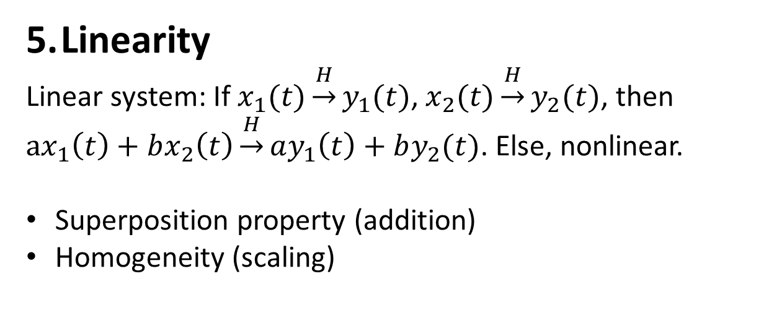
Linearity
Linear system: If $x_{1}(t)\underset{→}{H}y_{1}(t)$, $x_{2}(t)\underset{→}{H}y_{2}(t)$, then $ax_{1}\left(t\right)+bx_{2}\left(t\right)\underset{→}{H}ay_{1}\left(t\right)+by_{2}(t)$. Else, nonlinear.
Superposition property (addition)
Homogeneity (scaling)

Slide 21
Properties of a System:
On this course, we shall be particularly interested in signals with certain properties:
Causal: a system is causal if the output at a time, only depends on
input values up to that time.
Linear: a system is linear if the output of the scaled sum of two input signals is the equivalent scaled sum of outputs
Time-invariance: a system is time invariant if the system’s output is the same, given the same input signal, regardless of time.
These properties define a large class of tractable, useful systems and will be further considered in the coming lectures

